Slide 2
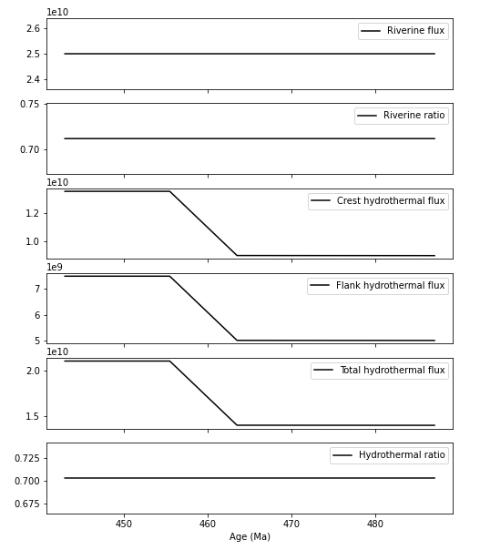
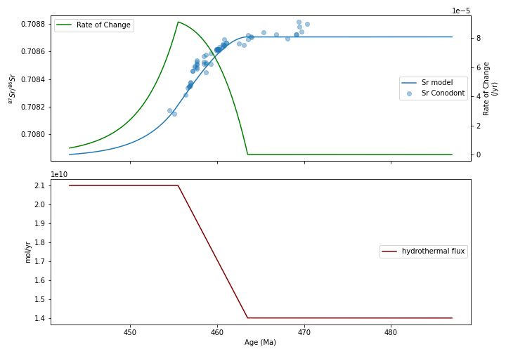
Model ver.0 (Ingram-style model)

Slide 3
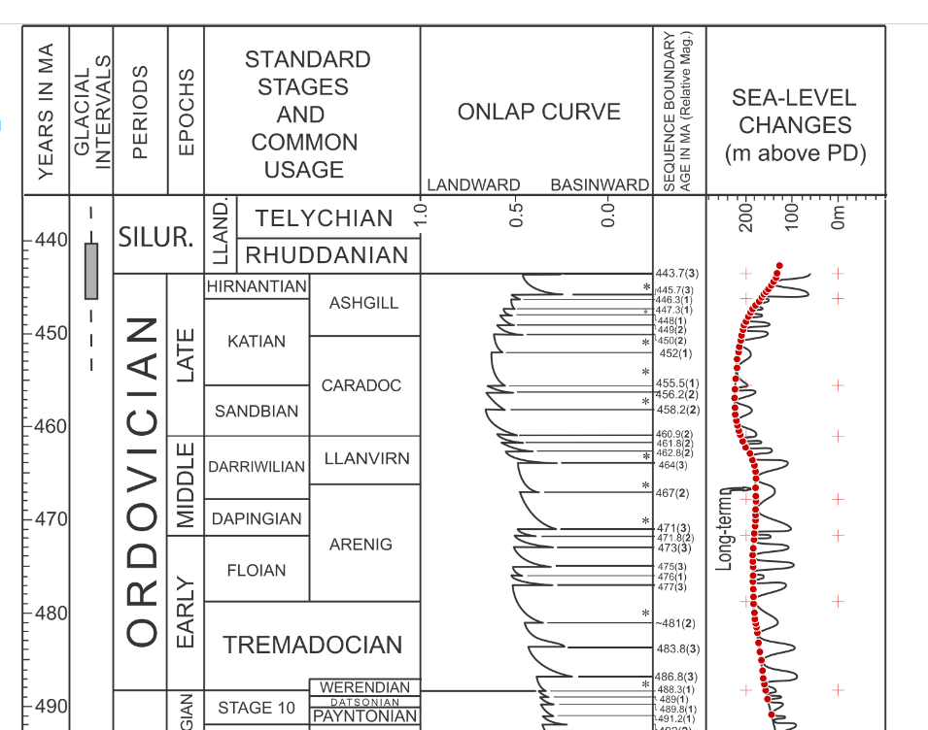
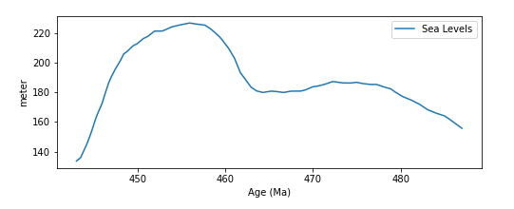
Model ver.01 (sea level curves driven model)
Hydrothermal Flux(t) = Jh0 x f(t)
where:
f(t) = sealevel(t) / mean_sealevel

Slide 4
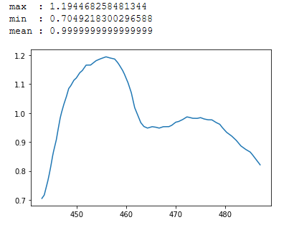
Model ver.01 (sea level curves driven model)
Hydrothermal Flux(t) = Jh0 x f(t)
where:
f(t) = sealevel(t) / mean_sealevel
f curve

Slide 5
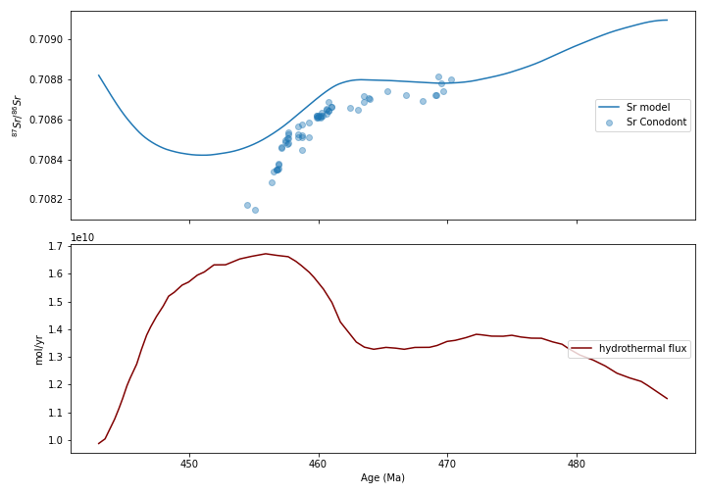
Model ver.01

Slide 6
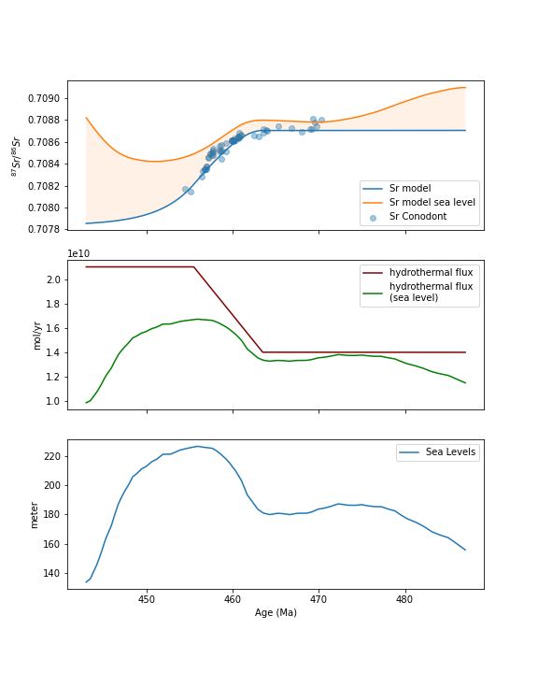
Comparison

Slide 7
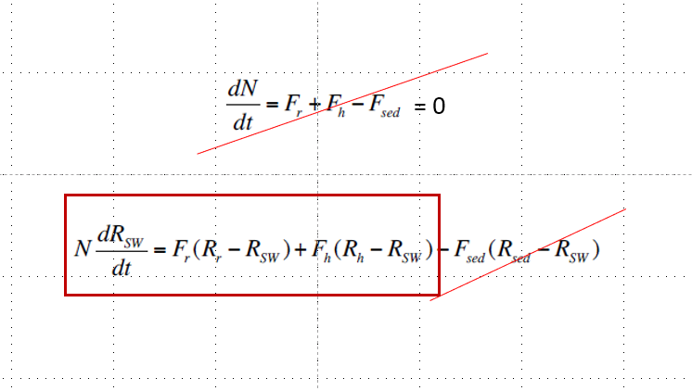
Constraining Fr and Rr
???

Slide 8
Riverine Ratio ??
Sr Isotopic Ratios of Archean and Grenvillian Rocks

Slide 9
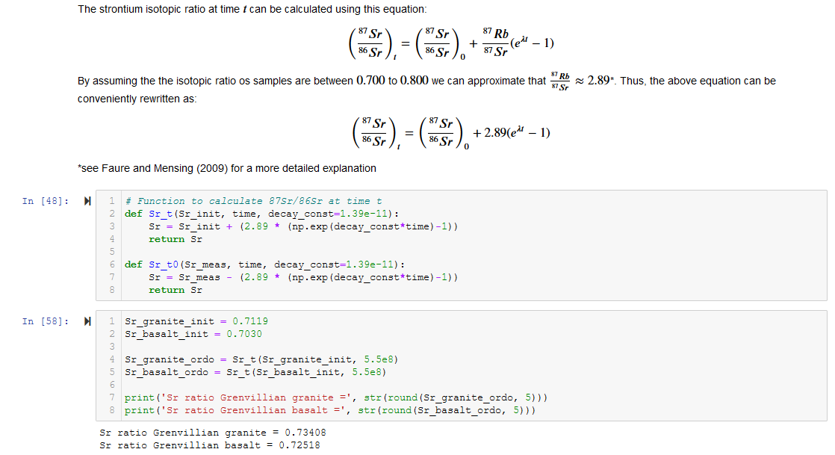
Approach #1

Slide 10
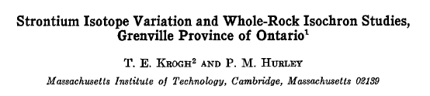
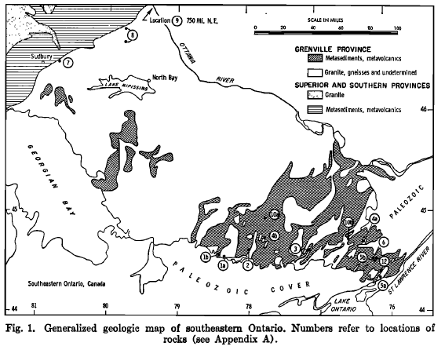
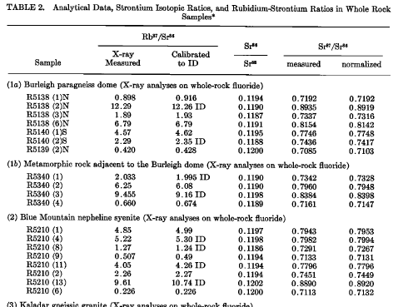
Approach #2
(Krogh and Hurley, 1968)

Slide 11
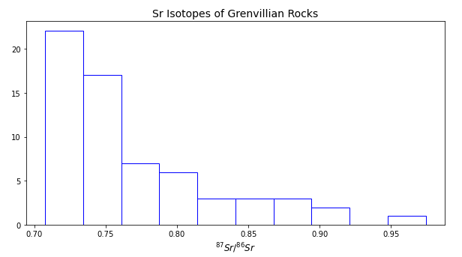
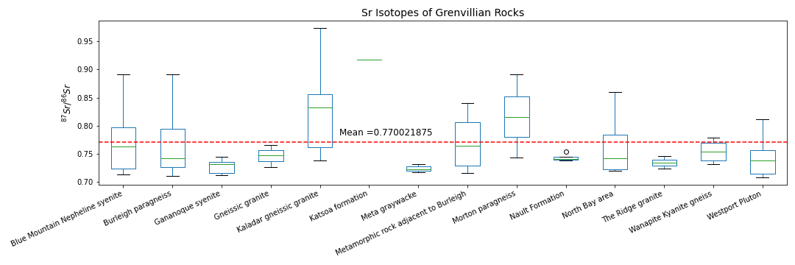
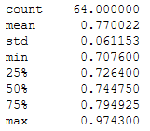
Approach #2
(Krogh and Hurley, 1968)

Slide 12
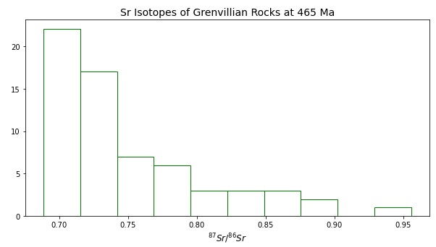
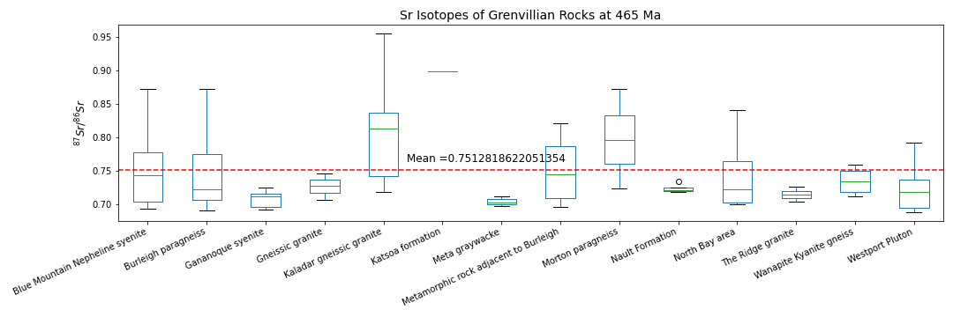
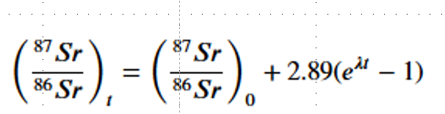
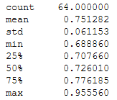
Approach #2 cont’d
(Krogh and Hurley, 1968)

Slide 13
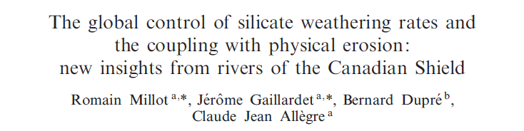
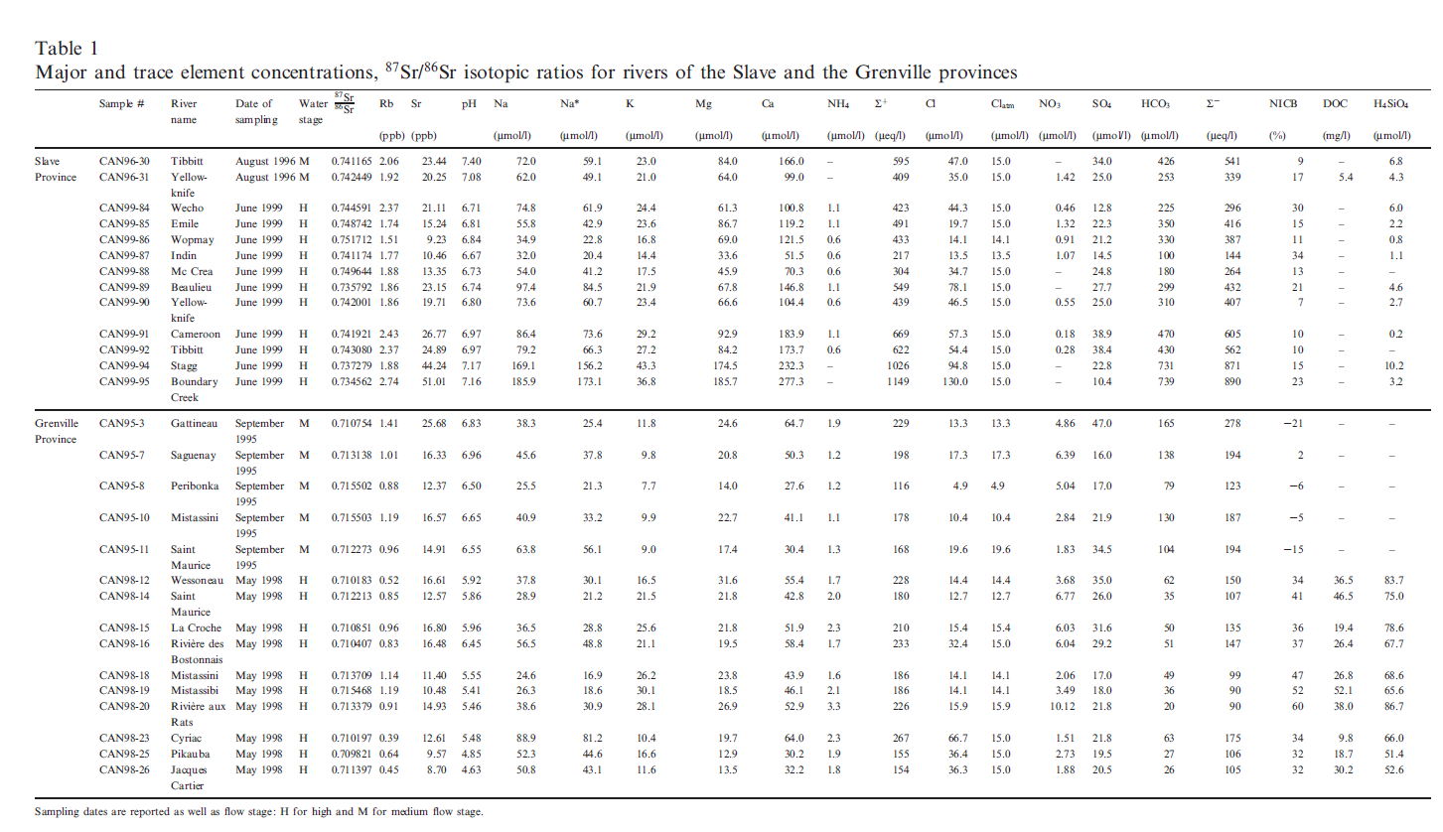
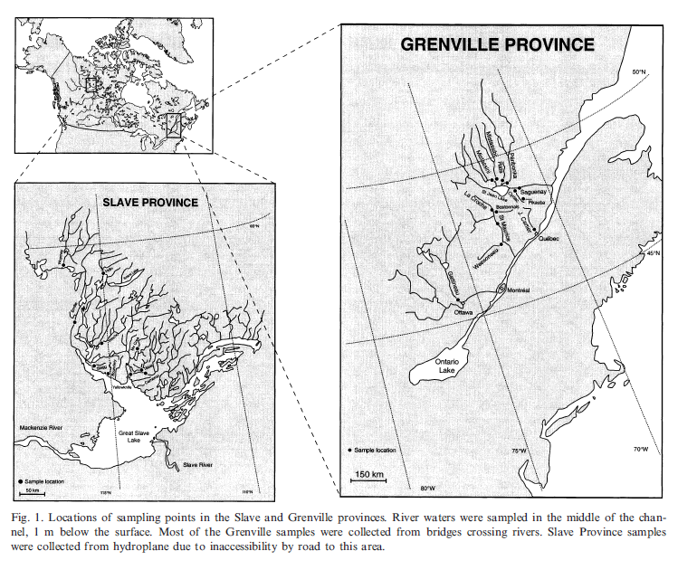
Approach #3
River Chemistry
(Millot et al., EPSL,2002)

Slide 14
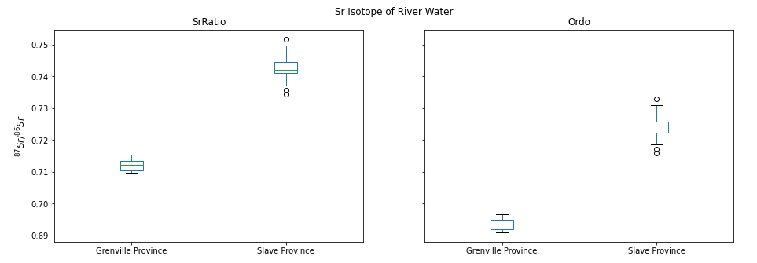
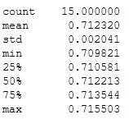
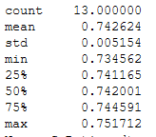
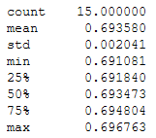
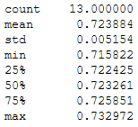
Approach #3

Slide 15
Summary
3 approaches to constrain Riverine ratios
granite – basalt mixing
metamorphic rocks
more radiogenic → Sr incorporation during metamorphism
river water
less radiogenic than expected
Riverine flux?
Laurentian source
Conwell et al model
..

Slide 16
Add Taconic Flux

Slide 17
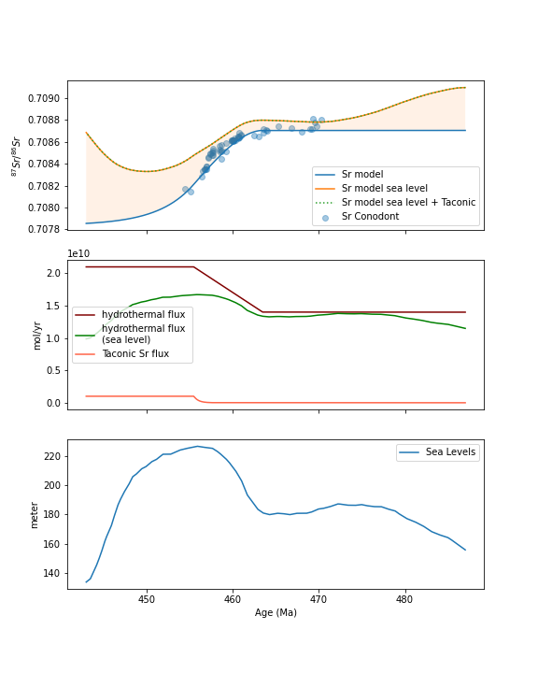
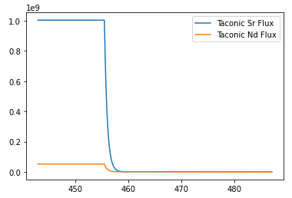
Adding Taconic based on Conwell et al model

Slide 18
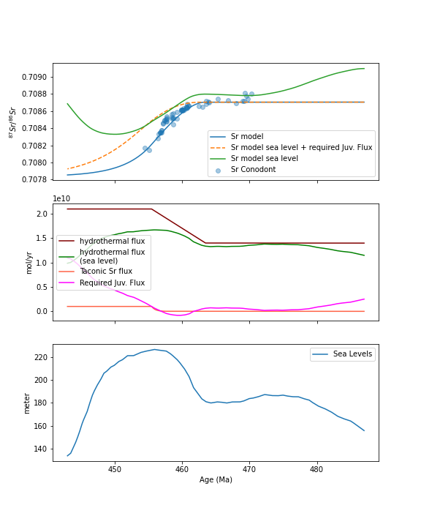

Estimating required juvenile flux
By making an assumption that during each time step the system behave as a steady state system we can make an estimation of the required juvenile flux to fit the data using this equation:

